Slide 1
IOTA Community Logo
IOTA
The distributed communication layer of tomorrow

Slide 2


DISCLAIMER:
NO FINANCIAL ADVICE WILL BE GIVEN IN THIS PRESENTATION

Slide 3
Index
whoami/whoarewe
Tangle deep dive
The IOTA Foundation
Use Cases
What today is about

Slide 4
Index
whoami/whoarewe
Tangle deep dive
The IOTA Foundation
Use Cases
What today is about

Slide 5


whoami/whoarewe
Name Surname
Your Title - yourwebsite.com
Following distributed ledger technology since 2011
Love Free and Open Source Software
Project with local company
Notes:
Present the organizers, speakers, supporters
Examples:
Your title, your line of work
what you do
when you started following IOTA

Slide 6
whoami/whoarewe
Name Surname
Your Title - yourwebsite.com
Following distributed ledger technology since 2011
Love Free and Open Source Software
Project with local company
Notes:
Present the organizers, speakers, supporters
Examples:
Your title, your line of work
what you do
when you started following IOTA

Slide 7
whoami/whoarewe
Name Surname
Your Title - yourwebsite.com
Following distributed ledger technology since 2011
Love Free and Open Source Software
Project with local company
Notes:
Present the organizers, speakers, supporters
Examples:
Your title, your line of work
what you do
when you started following IOTA

Slide 8




Technology
Governance
Ecosystem
Notes:
Important Puzzle Pieces
The Tangle and IOTA technology
The Governance by the IOTA Foundation
The Ecosystem around IOTA

Slide 9

The Tangle
The Tangle is the immutable data structure that contains a history of IOTA transactions.
Notes:
The Tangle is the immutable data structure that contains a history of IOTA transactions. All nodes in an IOTA network store a copy of the Tangle in their ledgers and can read from it and attach new transactions to it.
This removes completely the need to pay fees to miners and thus opens up the possibility to execute microtransactions which could be worth as little as a few cents.
Besides, IOTA’s DAG data structure allows for the network’s easy scalability. Everyone is participating in reaching a consensus and, therefore, the more people are using IOTA, the faster the network becomes.

Slide 10

The Tangle
The unique data structure being utilized in IOTA
Directed Acyclic Graph (DAG)
Scalable distributed framework for transactions
Transactions can hold data, value or both
Consensus
Notes:
DAG - The references among transactions form a type of directed acyclic graph (DAG), which is a sequence of vertices where every edge is directed from an earlier point to a later one in the sequence (the animation shows the three dimensional version)
Scalability - When a node attaches a new transaction to the Tangle, that transaction directly references two existing ones (make a simple multiplication to show how numbers grow)
Consensus - Network nodes are responsible for validating transactions and their histories to make sure that they don't conflict.
When a node has a transaction's entire history, the transaction is considered solid, which means that it can be considered for confirmation.
Resources for the speaker:
https://docs.iota.org/docs/dev-essentials/0.1/concepts/the-tangle

Slide 11
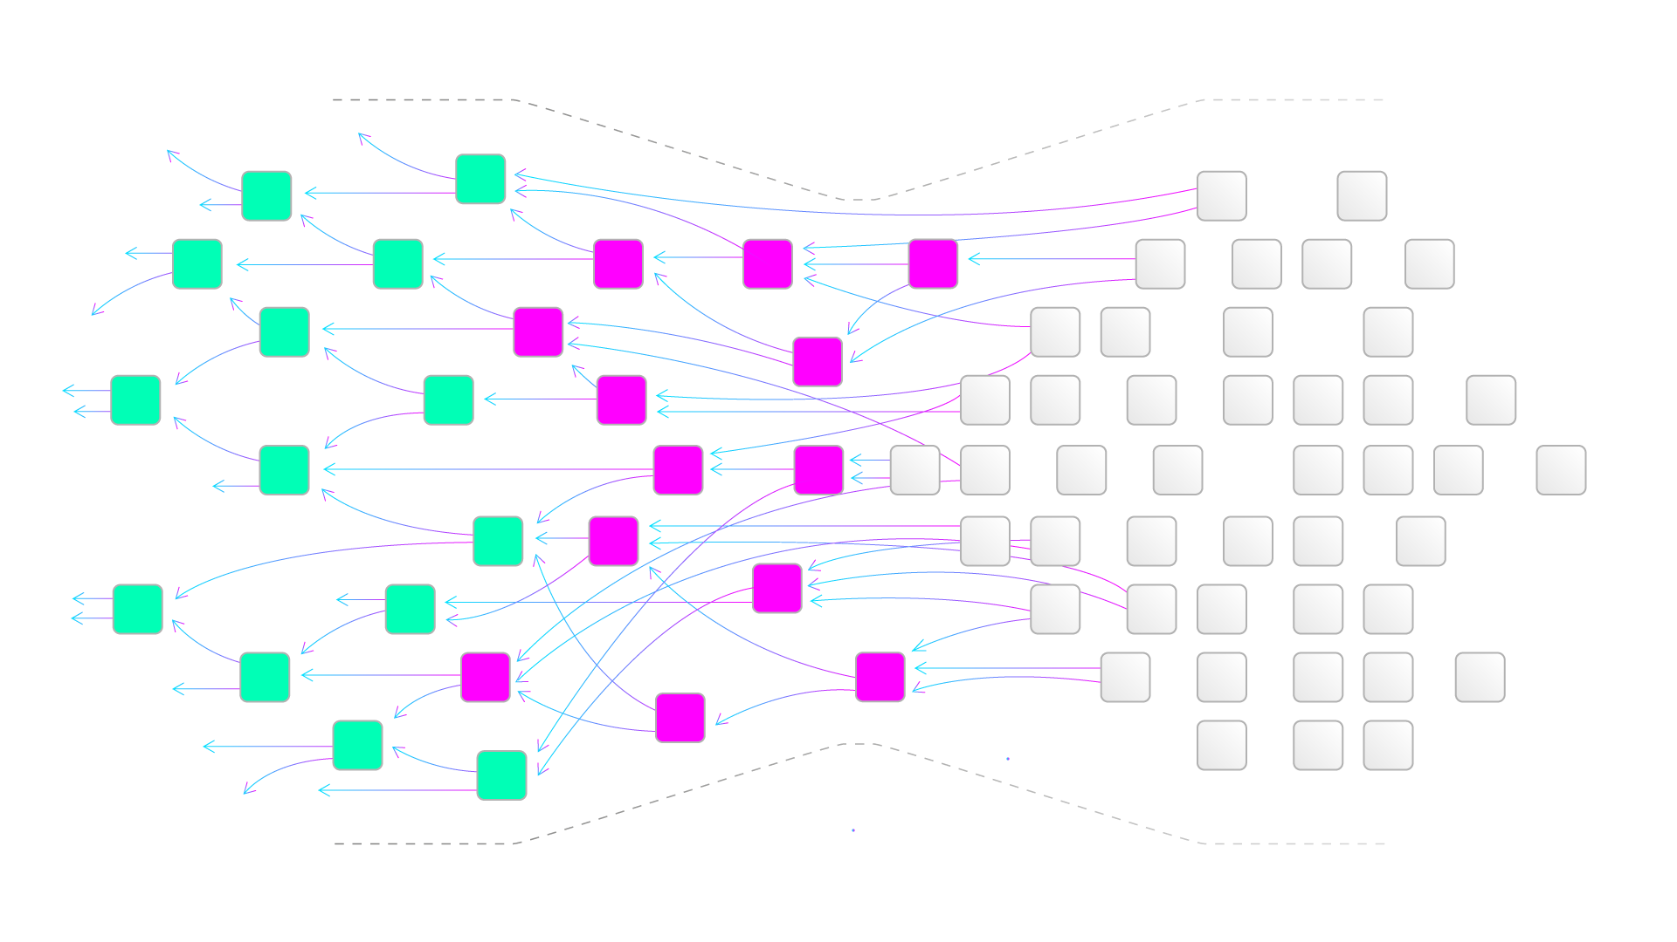

Tangle scales!
More activity
=
More validation
Notes:
Scalability - When a node attaches a new transaction to the Tangle, that transaction directly references two existing ones (make a simple multiplication to show how numbers grow)

Slide 12
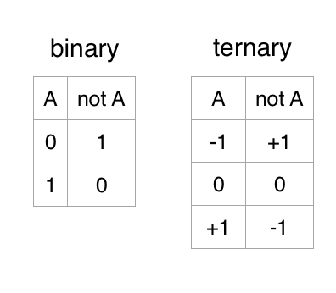


The IOTA Tangle - Ternary
Why Ternary?
Ternary is faster, more energy efficient and it also takes up less space
Ternary is very important for AI and NeuralNetworks
The ternary cryptographic environment can offer the following protections:
  Malware
  Breaches in access control will be reduced with the ternary PKD with the one-time public/private key pair
  Eavesdropping problems will be greatly reduced because all aspects of the ternary architecture can change constantly
Notes:
Institute of Electrical and Electronics Engineers
Continuously changing sets of ternary instructions on each machine, based on public key exchanges, are expected to make conversions between binary and ternary non-trivial;
The use of multi-factor authentication with subject–object pairing and passwords is suggested;
Ternary neural networks for resource-efficient AI applications
https://ieeexplore.ieee.org/document/7966166
Can Ternary Computing Improve Information Assurance?
https://www.mdpi.com/2410-387X/2/1/6/htm

Slide 13
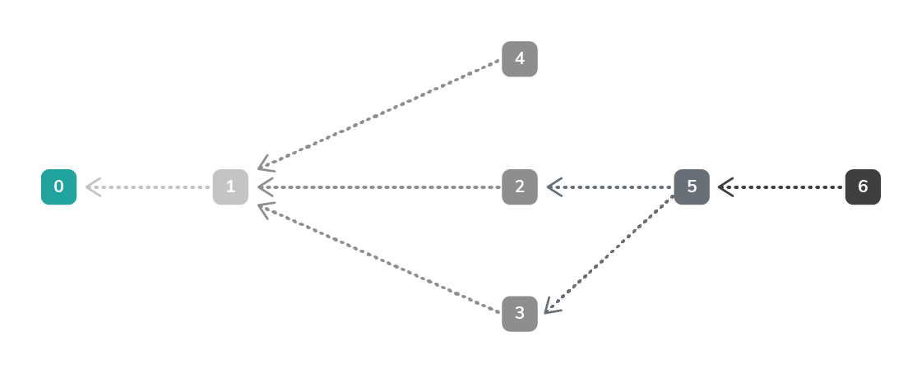
What is the Tangle?
Cryptographically referenced transactions
Nodes confirm transactions
Tip selection algorithm
Consensus
Coordinator (+ Coordicide)
In this diagram, each numbered box is a transaction. Transaction 5 directly references transactions 2 and 3, and transaction 6 indirectly references transaction 3 (through transaction 5).
Notes:
Transactions on the Tangle are immutable because their contents are cryptographically referenced to the history of two other transactions. So, if any transaction were to change in that history, all the references would be broken
The references among transactions form a type of directed acyclic graph (DAG), which is a sequence of vertices where every edge is directed from an earlier point to a later one in the sequence.
In the Tangle, vertices are transactions, and edges are references.
In this diagram, the numbered boxes represent transactions. The transactions on the left come first in the sequence, and the transactions on the right come after.
When a node attaches a new transaction to the Tangle, that transaction directly references two existing ones to the left of it.
Nodes decide which transactions to attach a new one to by doing tip selection.
References form a family tree, whereby if a new transaction is a child, the transactions hashes in its branch and trunk transaction fields are its parents.
In the diagram, transaction 6 directly references transaction 5, so transaction 5 is a parent of transaction 6. Similarly, transaction 6 indirectly references transaction 3, so transaction 3 is a grandparent of transaction 6.
These direct and indirect references make up a transaction's history.
A transaction can be valid only if it references two other transaction's whose history does not conflict with it.
For example, if transaction 6 instructs the node to withdraw 10 Mi from an address, the history of its parents must lead to a point where that address is sent at least 10 Mi.
Consensus
Nodes are responsible for validating transactions and their histories to make sure that they don't conflict. To validate a transaction, a node needs to have that transaction's history in its ledger.
Because the Tangle is distributed among all nodes in an IOTA network, some of them can have more or fewer transactions in their ledgers than other nodes. The transactions in any node's ledger make up its view of the Tangle.
So, to make sure that all nodes eventually have the same view of the Tangle, they forward any new transactions that they receive to their neighbors.
When a node has a transaction's entire history, the transaction is considered solid, which means that it can be considered for confirmation.
Nodes don't need the entire history of a transaction, starting from the first ever transaction to consider it solid.
Instead, nodes need the history of a transaction up to a predefined one, which is called an entry point. When the transaction's history goes far back enough to reference an entry point, the node stops solidifying it.
An example of a predefined entry point is a local snapshot.
For a transaction to be considered confirmed, nodes must reach a consensus on when to consider it final before they can update the balances of addresses.
A transaction is considered confirmed when it's solid and it's directly or indirectly referenced by a transaction that's sent and signed by the Coordinator.
This means that the transaction must be selected during tip selection when the Coordinator is creating a new milestone.
How a transaction becomes confirmed
Transactions on the Tangle can be in one of two states: Pending or confirmed.
When you send a bundle to a node, that bundle is pending and the node doesn't update the balances of the affected addresses until it's confirmed.
To go from a pending state to a confirmed state, nodes must reach consensus on the state of a transaction.
At the moment, nodes reach a consensus on transactions that are directly or indirectly referenced by a milestone (transaction that's created and sent by the Coordinator).
If transaction 6 were a milestone, then transaction 5, 3, 2, and 1 would all be confirmed.
These cryptographic references are transaction hashes. Each transaction has a unique transaction hash that's derived from its contents. As a result, the contents of a transaction are immutable.

Slide 14
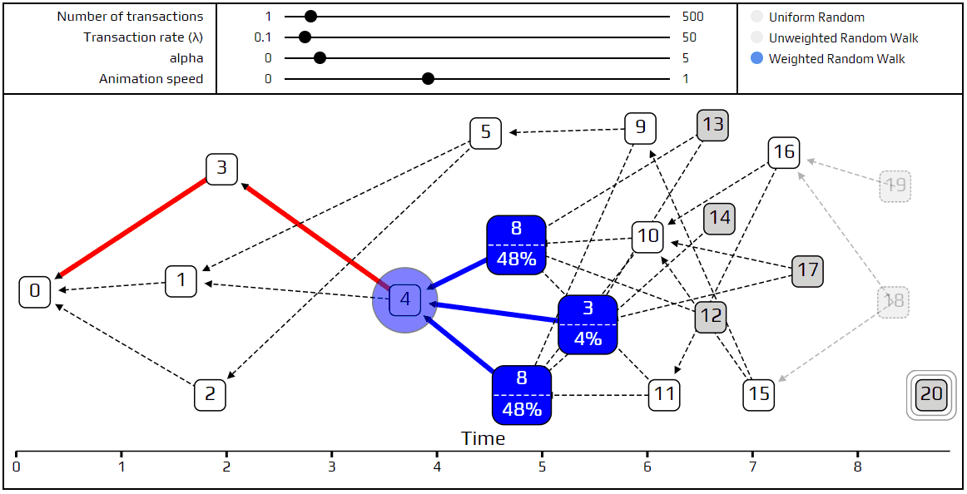
Tip selection
Tip
Weighted random walk
Markov Chain Monte Carlo
Notes:
In general, the tip selection algorithm selects transactions that have no parents. These transactions are called tips, hence the name 'tip selection'.
Although the tip selection algorithm is embedded in the IRI node software, it isn't enforced by the network. Instead, nodes are given an incentive to use the tip selection algorithm.
The node selects a subgraph (also known as a subtangle) of the ledger and does two weighted random walks through it. Each weighted random walk returns a tip transaction hash.
A weighted random walk is an algorithm that nodes use to find a path to a tip transaction in a subgraph.
To increase the probability of selecting a path to new transactions, the algorithm favors a path through transactions that have a higher rating. This rating is called a cumulative weight.
In a Markov chain each step does not depend on the previous one, but follows from a rule that is decided in advance.
Resources for the speaker:
https://docs.iota.org/docs/node-software/0.1/iri/concepts/tip-selection

Slide 15
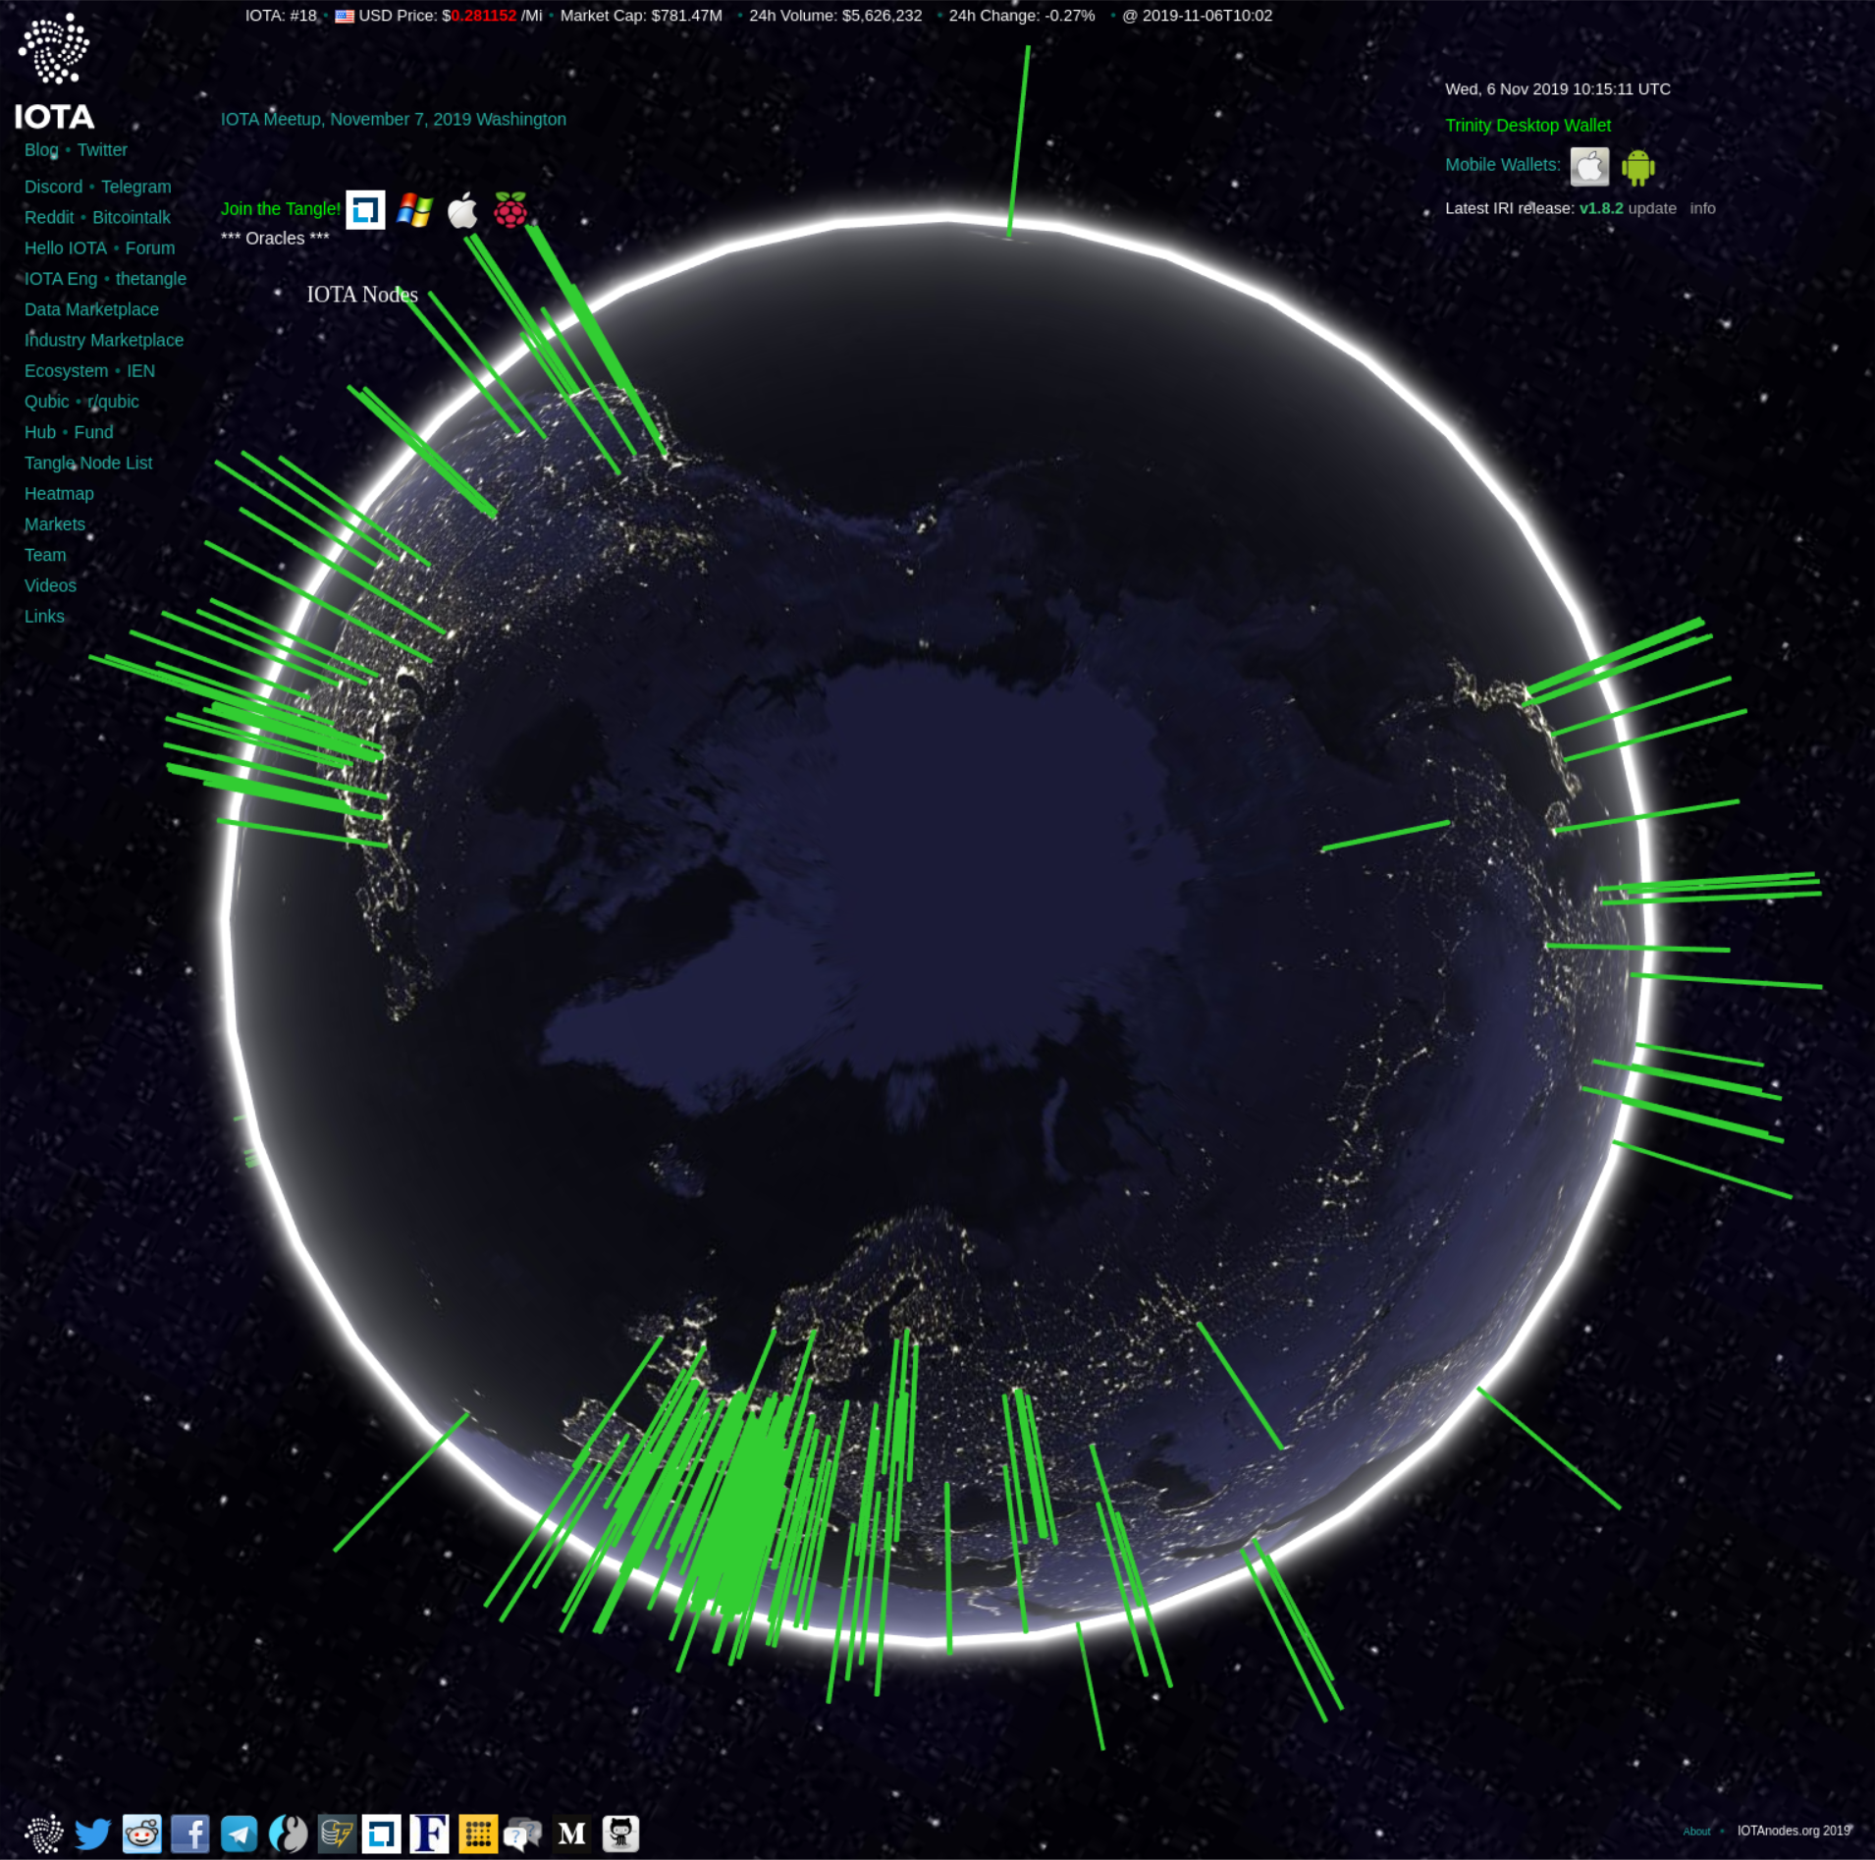
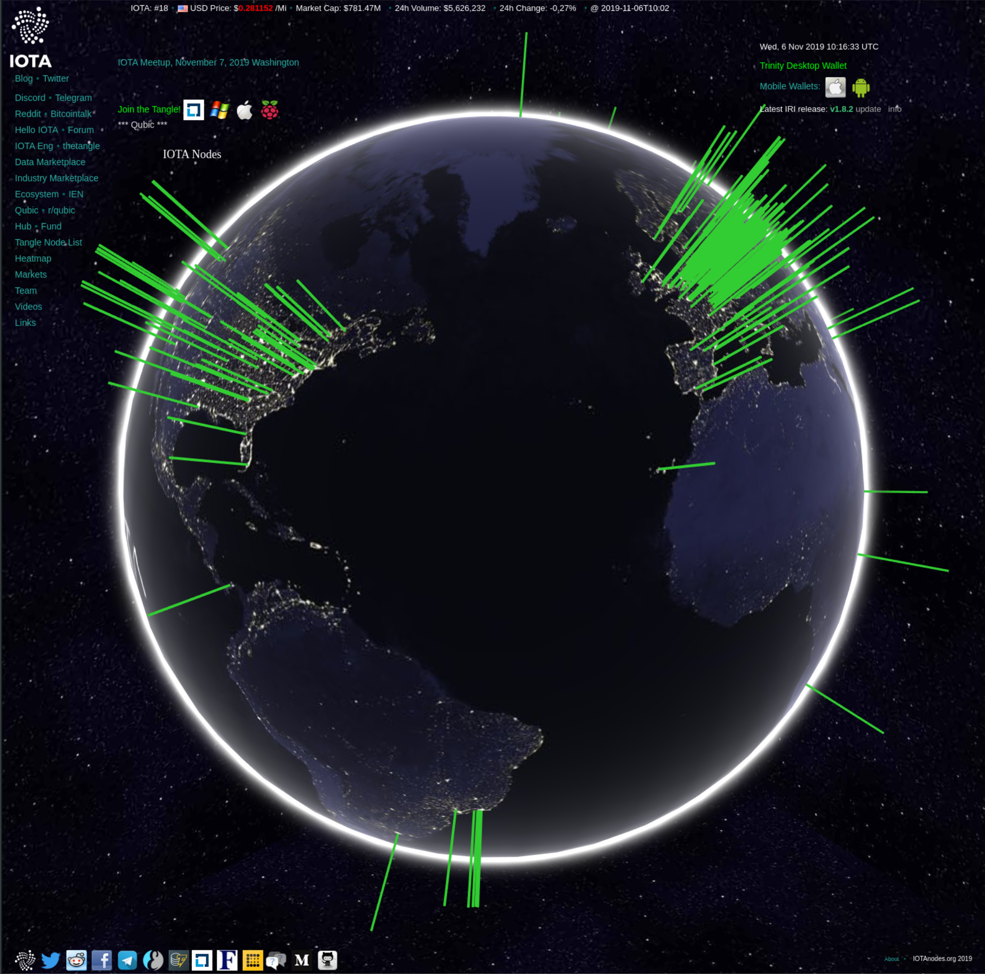
Consensus
Nodes validate transactions
Entry points
Solid transactions
Public nodes on https://iotanodes.org/
Notes:
Nodes are responsible for validating transactions and their histories to make sure that they don't conflict. To validate a transaction, a node needs to have that transaction's history in its ledger.
Because the Tangle is distributed among all nodes in an IOTA network, some of them can have more or fewer transactions in their ledgers than other nodes. The transactions in any node's ledger make up its view of the Tangle.
So, to make sure that all nodes eventually have the same view of the Tangle, they forward any new transactions that they receive to their neighbors.
When a node has a transaction's entire history, the transaction is considered solid, which means that it can be considered for confirmation.
Nodes don't need the entire history of a transaction, starting from the first ever transaction to consider it solid.
Instead, nodes need the history of a transaction up to a predefined one, which is called an entry point. When the transaction's history goes far back enough to reference an entry point, the node stops solidifying it.
An example of a predefined entry point is a local snapshot.
For a transaction to be considered confirmed, nodes must reach a consensus on when to consider it final before they can update the balances of addresses.
A transaction is considered confirmed when it's solid and it's directly or indirectly referenced by a transaction that's sent and signed by the Coordinator.
This means that the transaction must be selected during tip selection when the Coordinator is creating a new milestone.

Slide 16

The Coordinator - Compass
The Coordinator
Milestones
Notes:
The Coordinator is an application that creates, signs, and sends bundles of transactions from the same address at regular intervals. Each of these bundles contains transactions called milestones that nodes use to reach a consensus. When milestones directly or indirectly reference a transaction in the Tangle, nodes mark the state of that transaction and its entire history as confirmed.
The Coordinator sends milestones to nodes at regular intervals, and nodes use these milestones to reach a consensus.
When nodes see a transaction that's been sent from the Coordinator's address, they validate it by doing the following:
Make sure that it doesn't lead to a double-spend
Verify its signature
Because IOTA uses the Winternitz one-time signature scheme (W-OTS), addresses must not be withdrawn from more than once. To allow the Coordinator to sign multiple bundles whose signatures can still be verified against one address, that address is derived from the Coordinator's Merkle tree.

Slide 17
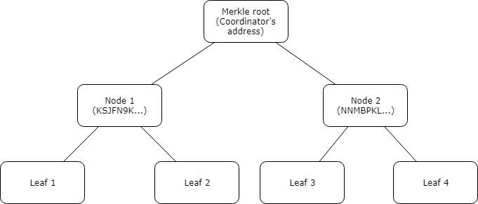
Compass merkle tree
The Merkle tree
Nodes verify milestones
Notes:
Notes to speaker:
Skip this slide if too technical for you or your audience and direct them to read more on the documentation portal docs.iota.org
A Merkle tree is a data structure that starts by hashing data at the leaves and ends at the Merkle root (the Coordinator's address).
Example Merkle tree
The Coordinator can sign and send one signed bundle for each leaf in its Merkle tree.
In this example, we have four leaves, which each represent one of the Coordinator's public/private key pairs. These key pairs are created in advance and used to compute the the Coordinator's address. The total number of key pairs in a Merkle tree depends on its depth in this formula: 2depth. In this example, the Merkle tree's depth is 2.
To verify milestones, nodes must rebuild the Merkle tree to find the Merkle root. If the rebuilt Merkle root is the same as the Coordinator's address, nodes know the milestone was sent by the Coordinator.

Slide 18
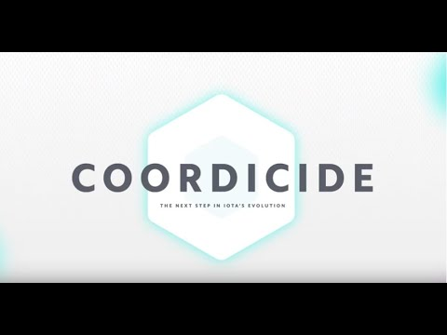
The Coordicide
https://youtu.be/guNNqEeu6gY

Slide 19
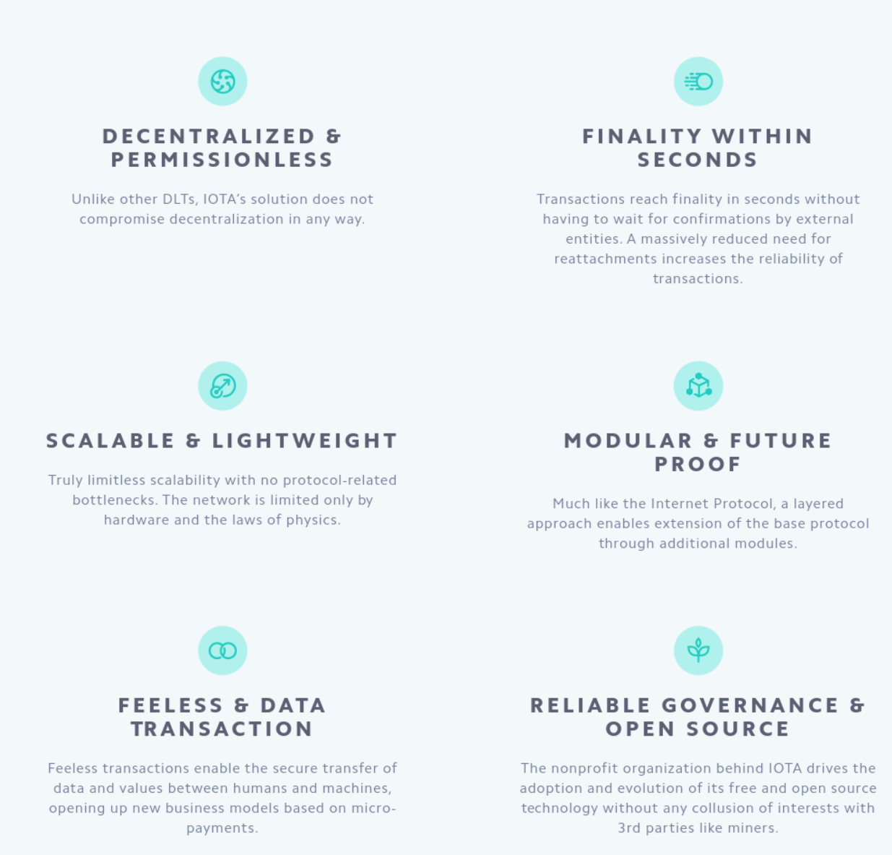
The Coordicide
Node Identities
Auto-peering
Spam Protection
Tip Selection
Shimmer
Notes:
NODE IDENTITIES
Build a reputation and help secure the network by being a good actor.
AUTO-PEERING
Connect to the network automatically, simplifying node setup and maintenance.
SPAM PROTECTION
Enables low-powered IoT devices to access the network through an adaptive rate control mechanism.
TIP SELECTION
An optimized tip selection algorithm improves confirmation times and ensures transaction confirmation.
SHIMMER
The revolutionary voting module reaches a consensus in seconds. By leveraging proactive communication in the network it enables near-instant irreversible transactions.

Slide 20

Introduction to the IOTA protocol
IOTA is a distributed ledger technology that allows devices to transfer immutable data and value among each other

Slide 21
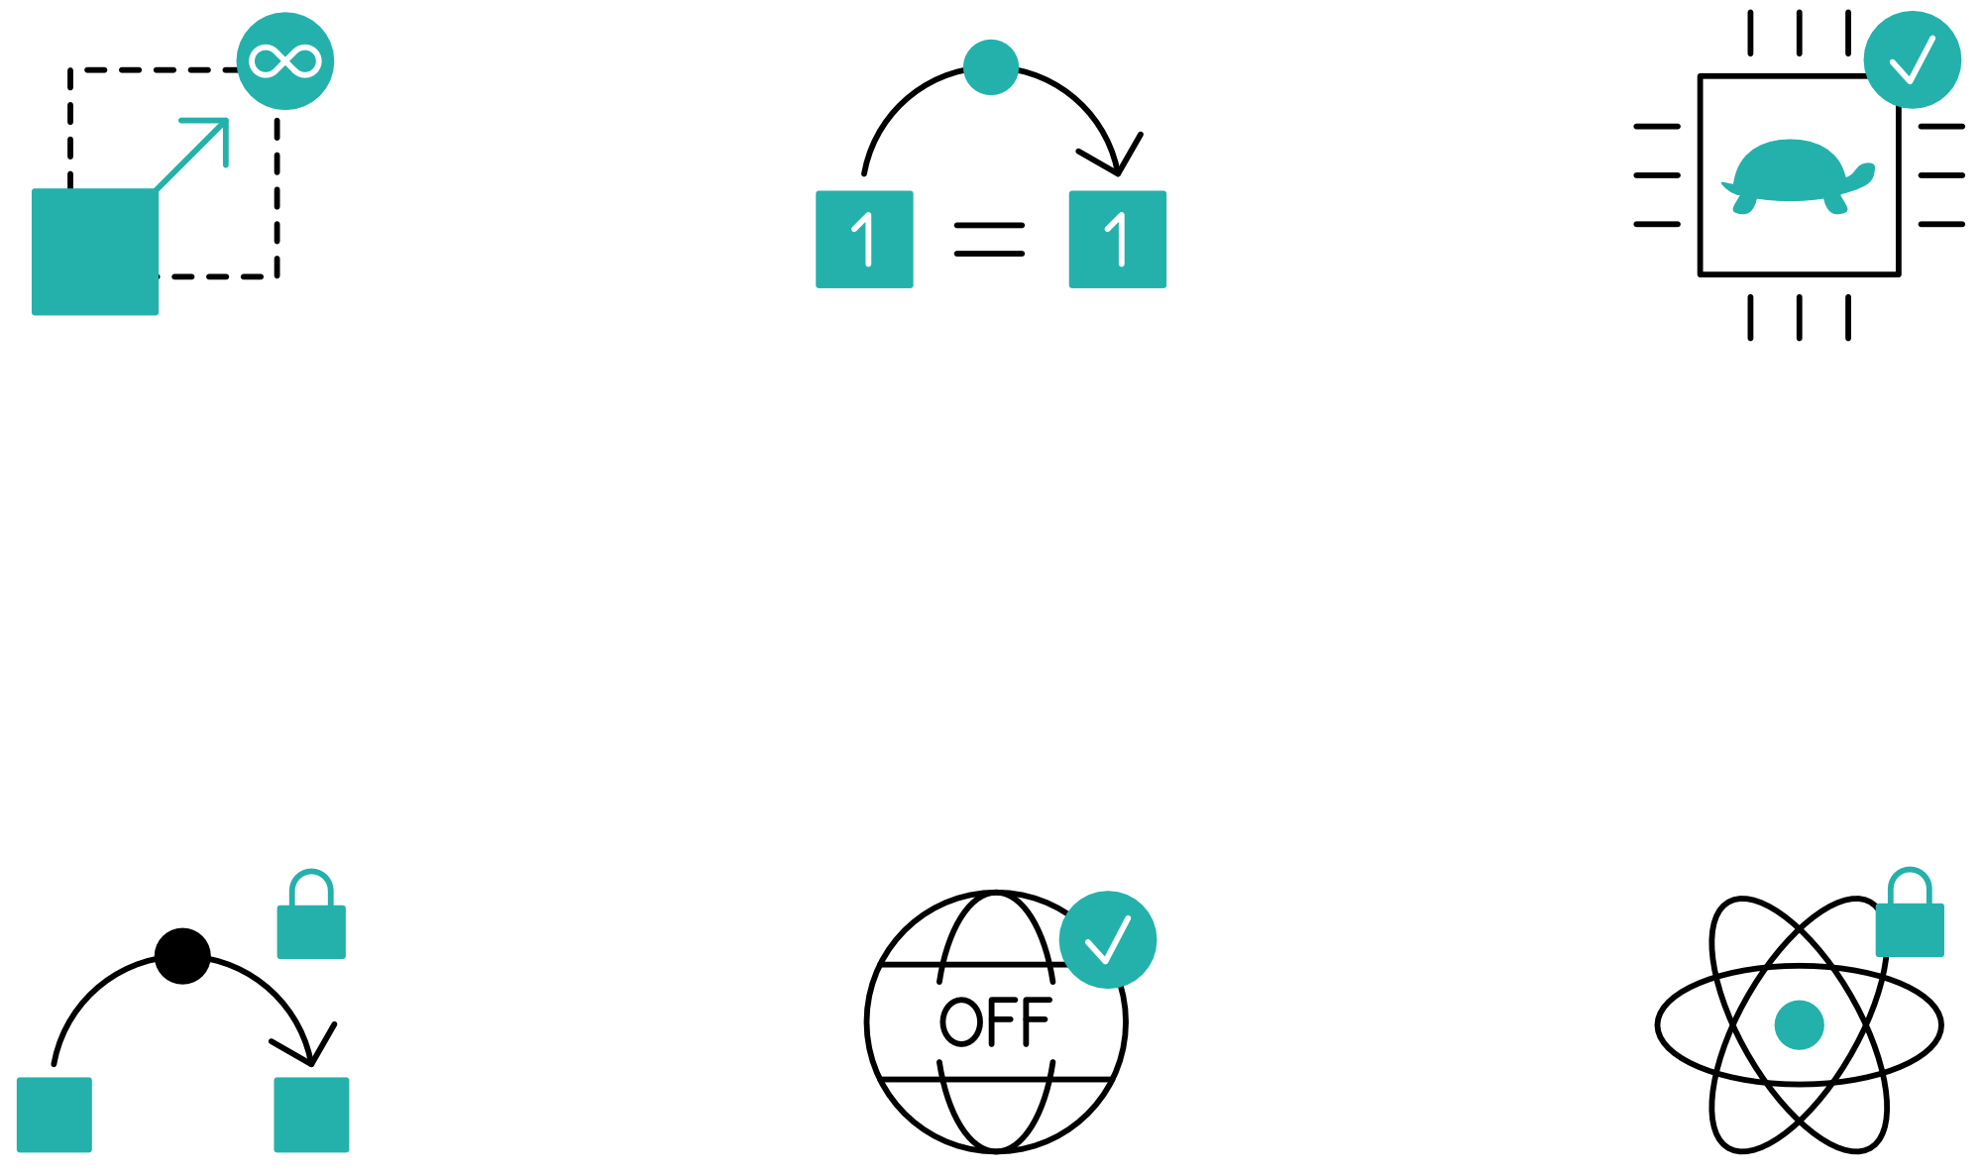
Introduction to the IOTA protocol
Highly scalable
Zero-fee transactions
Overcoming
the limitations of
Blockchain
Immutable
data transfer
Quantum robust
Notes:
IOTA is:
- permissionless, which means that anyone can use the network to make payments or send data. You don't need to sign up, give away your personal details, or pay a subscription.
- decentralized: no entity (e.g. government can take it down)
- transparent: how it works is transparent and the open source code can be audited anytime
- has tokens: the same layer that transports data can also transport value, therefore it is a starting point for the machine-2-machine economy
The cryptographic functions in the IOTA protocol allow you to benefit from the following:
Authenticity: Prove that you sent a transaction and that you own the data or IOTA tokens in it
Integrity: Prove that your transaction is unchanged
Confidentiality: Control who has access to your data through encryption
Resources for the speaker:
https://docs.iota.org/docs/getting-started/0.1/introduction/what-is-iota

Slide 22






Use-Cases
Telecom
Mobility
Digital Economy
- Payments
- Settlement
- Data Sharing
- Data Integrity
- Identity Management
- Smart Charging
- Over-the-Air Updates
- Car ID & Wallet
- Cars as Autonomous
Economic Agents
- Usage Based Insurance
- Car Paying for Parking
- M2M Economy
- MyData & GDPR
- Biometric Authentication
& Digital ID
- IOTA Data Marketplace
- Smart Factory
- Digital Twin
Smart City
Supply Chain
Social Impact
- Digital ID
- Smart Energy Districts
- P2P Energy Grid
- Cross vertical
- Biometric Identification
- CityxChange Smart
Cities
- Asset Tracking
- Connected Supply Chains
- Global Trade Document Flow
- Product Authenticity and
Provenance
- Ports Management
- New Insurance Models
- Digital ID & Citizen Services
- Humanitarian ID
- Real-time Environmental
Monitoring
- Financial Inclusion
Notes:
Resources for speaker:
https://files.iota.org/comms/IOTA_Use_Cases.pdf

Slide 23

The IOTA Foundation
The IOTA Foundation - to research, develop and grow market adoption of DLT
Non-profit Foundation based and regulated in Berlin, Germany
Growth from 6 to 100+ full time employees distributed across 27 countries
Focused on technical and regulatory challenges of crypto-currencies & DLT
Notes:
Make sure to emphasize that IF's goal is to be irrelevant in 5 years. One of many actors guiding, building, using the Tangle

Slide 24

IOTA Foundation - Vision & Goals

Slide 25

IOTA Ecosystem
Our universe relies on a network of many collaborators
– corporates, academics, governments, NGOs
Notes:
Sources for official Ecosystem
https://blog.iota.org
https://ecosystem.iota.org
Sources for unofficial Ecosystem:
https://iota-archive.com/

Slide 26

IOTA Ecosystem
Meet the IOTA Ecosystem
Tutorials
Projects
Events
Developers
Notes:
The IOTA Ecosystem is a hub of education, innovation, tools, collaboration and development for the IOTA distributed ledger protocol and is lead by the IOTA Foundation.
The Ecosystem also is responsible for the Ecosystem Development Fund.
Resources for speaker:
https://ecosystem.iota.org

Slide 27

IOTA Ecosystem Development Fund
Funding for projects in the IOTA Ecosystem
Proof of concepts
Open source utilities and libraries
Educational resources
Media
Philanthropic endeavors
Hackathons
Ideation workshops
Meetups
Notes:
Ecosystem Development Fund Is a collection of donations that are granted to IOTA related projects
Is committed to Transparency, accountability and by memorializing EDF funding agreements with ‘Proof-of-Existence’ transactions on the Tangle, anyone will be able to verify that agreements the EDF enters existed in a certain state at a certain point in time. The IOTA community can thus hold both the EDF and the benefactors of EDF
Resources for speaker:
https://fund.iota.org

Slide 28

Coordicide Grant Program
Research Grant
e.g.
Optimization of the networking layer to avoid network congestion
Reputation system based on node behavior
Theoretical behavior of cellular automata based consensus
Theoretical properties of query-based voting schemes (e.g., FPC)
https://coordicide.iota.org/grants
Notes:
This project is IOTA’s top priority, and there is the possibility to collaborate through the Coordicide grant program, which offers both large and small grants for research on any aspect of Coordicide.

Slide 29

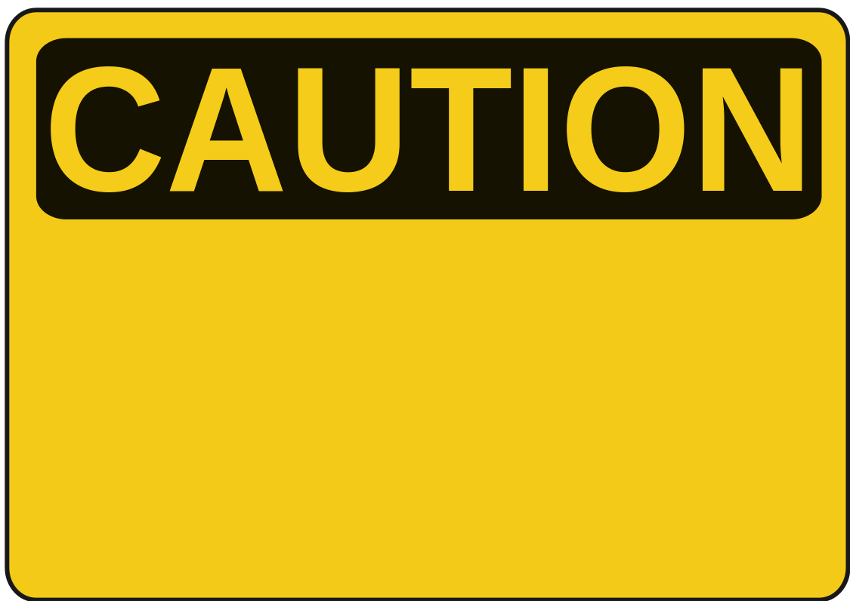
Mobility & Automotive - PoC by bIOTAsphere
Insuremycar PoC
Dynamic insurance provider
Direct payments
Vehicle monitoring
Proof-of-Concept
NOT endorsed by Tesla
Notes:
Resources for speaker:
https://youtu.be/6VYQYlzNPFs

Slide 30


IIoT/IoT - Bosch XDK
Fast and easy IOTA integration for prototypes
Secure and immutable sensor data transmission via IOTA
Micropayments on the (Industrial) Data Marketplace
Bosch XDK110 and
Masked Authentication Messaging
Notes:
Resources for the speaker:
XDK2MAM: https://xdk2mam.io
Data marketplace open source blueprint: https://docs.iota.org/docs/blueprints/0.1/data-marketplace/overview
Industry Marketplacehttps://industry.iota.org/

Slide 31
Contacts:
Sponsors:
Get involved:
email@provider.com
website.com
twitter.com/myhandle
linkedin.com/in/mylink
<SPONSOR NAME>
<Description>
sponsor.website.com
Website:
Ecosystem:
Discord:
Twitter:
LinkedIn:
YouTube:
www.iota.org
ecosystem.iota.org
discord.iota.org
twitter.com/iotatoken
linkedin.com/company/iotafoundation
www.youtube.com/c/iotafoundation

